Slide 1
Cyclistic Bike-Share
Analyzed by Sahrial

Slide 2
AGENDA
Background
Company Profile
Preparing Data
Cleaning Data
Analyze the Data
Customer Segmentation
Customer Used Bike
Bike Type Used
Visualization
Insights & Recommendation

Slide 3

Background
Design marketing strategies aimed at converting casual riders into annual members. In order to do that, however, the marketing analyst team needs to better understand how annual members and casual riders differ, why casual riders would buy a membership, and how digital media could affect their marketing tactics.

Slide 4
ABOUT CYCLISTIC
In 2016, Cyclistic launched a successful bike-share offering. Since then, the program has grown to a fleet of 5,824 bicycles that are geotracked and locked into a network of 692 stations across Chicago. The bikes can be unlocked from one station and returned to any other station in the system anytime.

Slide 5
Preparing Data

Slide 6
How to Prepare the data?
Primary data from the Company
Data is created per month in csv format (12 datasets)
Combine data is done using R to become 1 whole dataset

Slide 7
Cleaning Data

Slide 8
How to Clean the data?
Removing duplicates
Removing blank lines
Removing whitespace
Adding columns (ride length, day of week and month)
Change some columns to categorical (day of week, month, rideable type and member casual)

Slide 9
Analysis 1
Customer Segmentation

Slide 10
Facts
There are 3,35M Member and 2,32M Casual of Cylistic pada Tahun 2022
Tercatat 59,03% menjadi member aktif dan 40,97% pengguna Casual pada Tahun 2022
Baik Member dan Casual mengalami peningkatan pada 2 kuarter pertama Tahun 2022. Sedangkan kuarter ketiga mulai mengalami penurunan

Slide 11
Analysis 2
Customer Used Bike

Slide 12
Facts
Average time of Member used bike is 13 Minutes
Average time of Casual used bike is 29 Minutes
Member is not use Docked Bike
The most used bike for Casual riders is Docked Bike
The most used bike for Member riders is Classic Bike
Casual riders menghabiskan waktu lebih banyak dalam menggunakan Cylistic. Terutama Docked Bike (100-200 Menit), Sementara jenis lainnya dalam rentang 10-30 menit)
Sementara itu Member riders menghabiskan waktu lebih sedikit dalam menggunakan Cylistic (10-14 menit)

Slide 13
Analysis 3
Bike Type Used

Slide 14
Facts
Electric Bike is the most used bike (50,97%)
Classic Bike used by 45% customers
Docked Bike used by 3,13% customers
Kuarter pertama dan kedua mengalami kenaikan total sepeda dipinjam. Bulan Juni merupakan puncaknya
Kuarter ketiga dan keempat mengalami penurunan total sepeda dipinjam. Bulan Desember merupakan yang paling rendah.
Secara keseluruhan bulan Januari paling sedikit sepeda digunakan, sedangkan bulan Juni paling banyak.
Hari terlama menggunakan Sepeda adalah Weekend (Sabtu dan Minggu)

Slide 15
Visualization

Slide 16
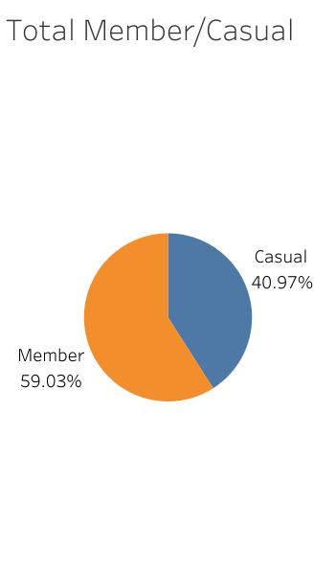
Customer Segmentation
Member riders amounted to 3.35M or 59.03% of all customers
Total casual riders amounted to 2.32M or 40.97% of all customers

Slide 17
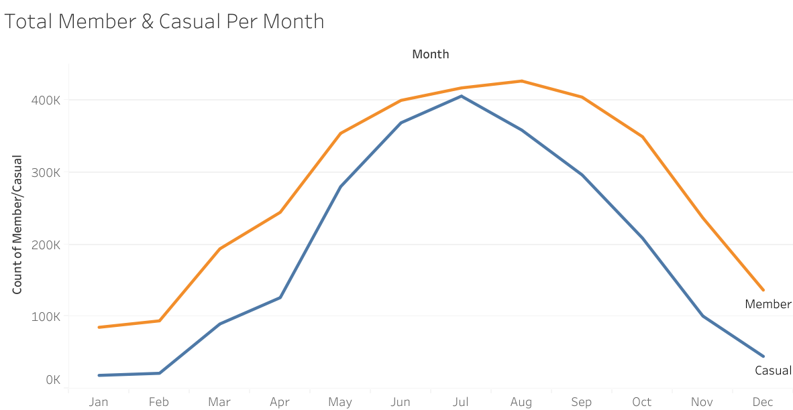
Customer Segmentation
The first - second quarters saw an increase in customers.
The third and fourth quarters saw a decrease in customers.

Slide 18
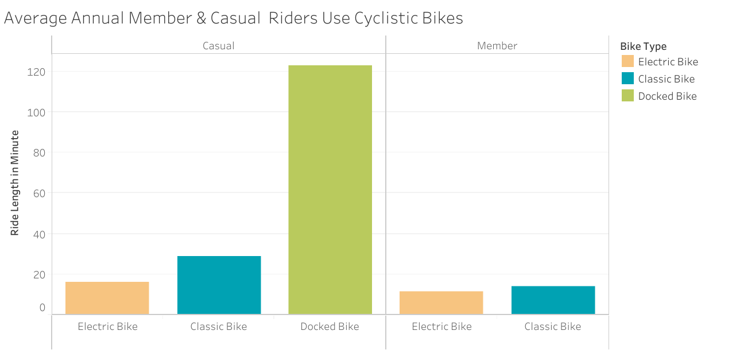
Penggunaan Cylistic oleh Pengguna
Casual riders use Docked Bike the longest (100-120 minutes), while Member riders Classic Bike (10-13 minutes).
Member riders do not use Docked Bike

Slide 19
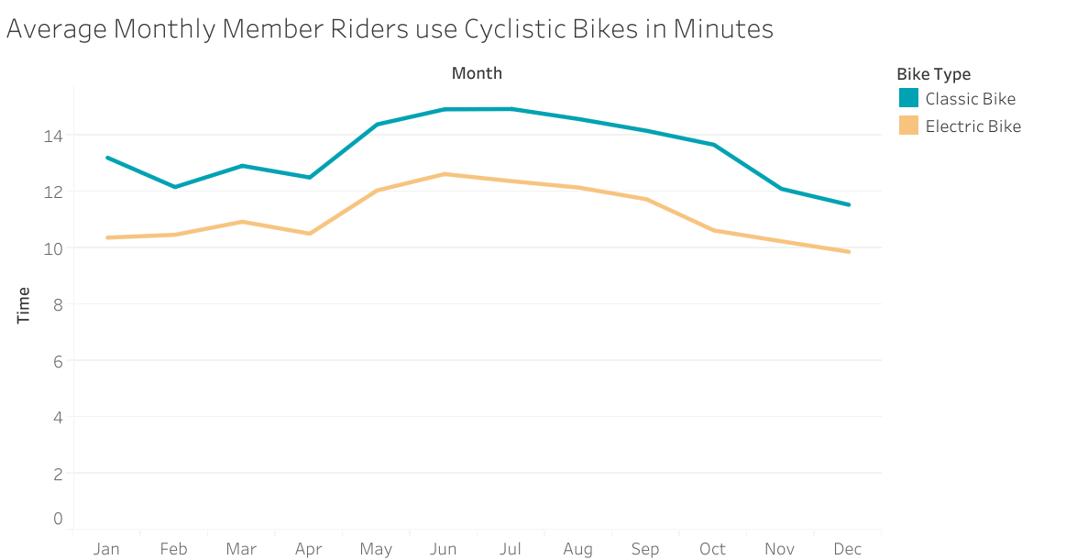
Penggunaan Cylistic oleh Member Per Bulan
Member riders mostly use bicycles from May to early July.
The decline in bicycle usage occurs from mid-July - December

Slide 20
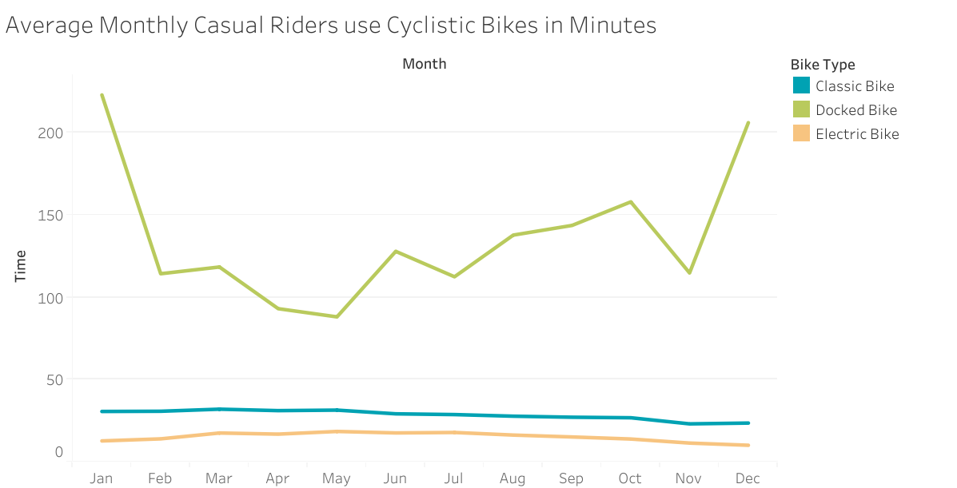
Pengguaan Cylistic oleh Casual Per Bulan
Casual riders use Classic Bike (23-33 Minutes) and Electric Bike (12-18 Minutes) constantly.
Docked Bike usage fluctuates.

Slide 21
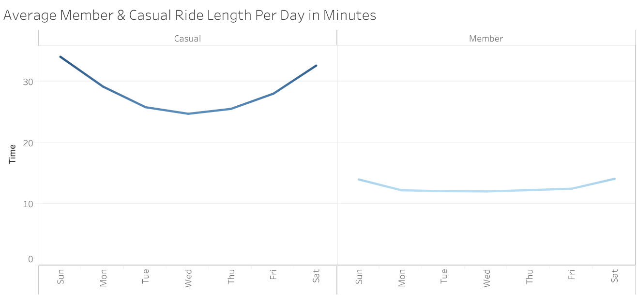
Pengguaan Cylistic per Hari
Weekend is the day we spend the most time cycling
Tuesday, Wednesday and Thursday do not spend much time cycling
Casual riders spend more time cycling than member riders.

Slide 22
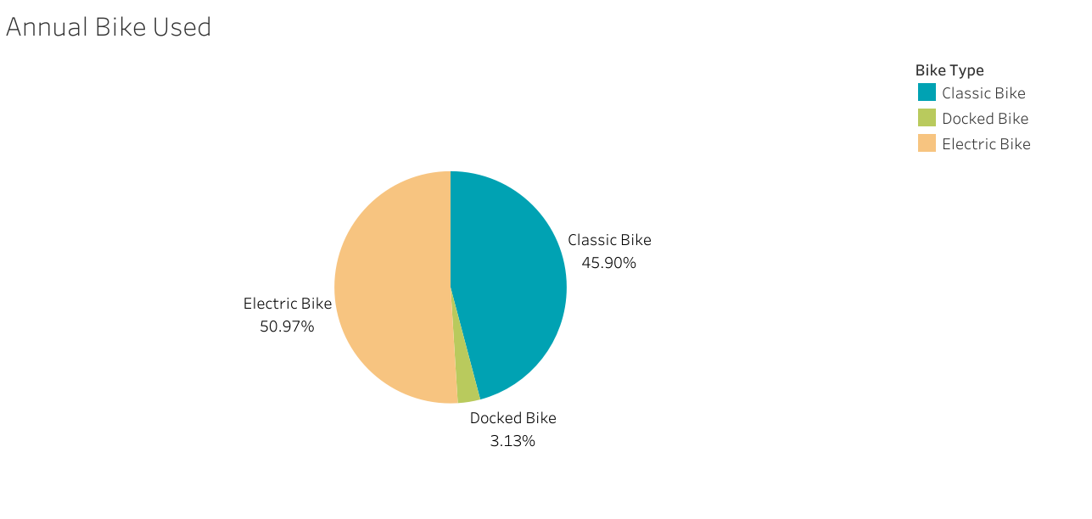
Annual Bike Used
Electric Bike by far the most used in 2022
Electric Bike is used by about 2.84M Users
Classic Bike is used by about 2.6M Users
Docked Bike is used by around 177.4K Users

Slide 23
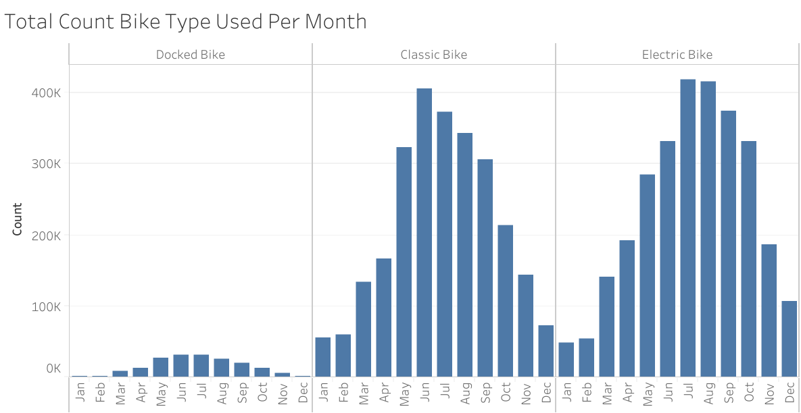
Monthly Bike Used
Fewest users used bicycles in January and February
The first and second quarters saw an increase in total bikes borrowed. June was the peak.
The third and fourth quarters saw a decrease in total bikes borrowed. December was the lowest.

Slide 24
Insight & Recommendation
Docked Bike is never used by Member Riders, Company can increase marketing of Docked Bike to Member Riders.
Cyclistic usage is longer by Casuals, to convert to Members, the Company can make marketing promotions such as subscription offers to Casual Riders.
January and February are the lowest months of Cyclistic bike usage. Use marketing strategies such as National Holiday Discounts to get customers back.
There is a decline in the number of customers from July-December. Use marketing strategies such as Public Holiday Discounts to get more customers.

Slide 25
Thanks!
Do you have any questions?

Slide 26


